Slide 1

WHO recommendations on HTS, HIV testing strategy, and HIV algorithm transition
Dr Alaleh Abadpour, WHO Global HIV, Hepatitis, and STIs Programme, HQ

Slide 2
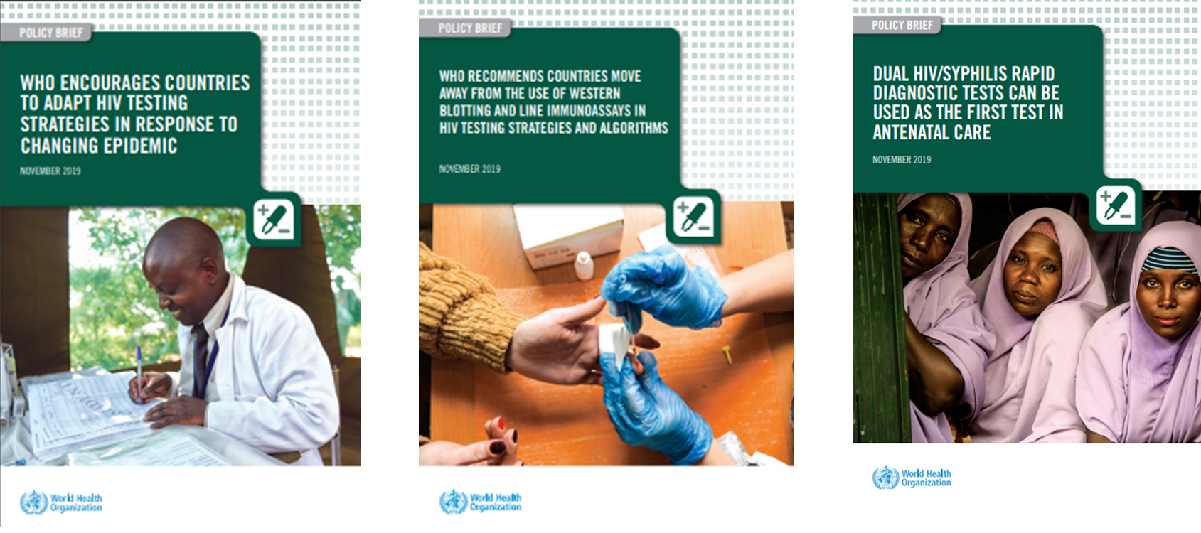

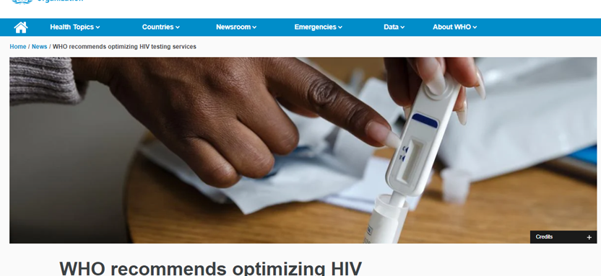
Presentation Outline
95-95-95 Goal and Epidemiological Profile Latin America and the Caribbean
Evidence and Rationale for Using WHO HIV 3-test Algorithms
  3 consecutive reactive tests for a positive diagnosis
  Reminder of 2019 guidelines and updates in the new HTS guidelines
  Cost consideration of Retesting before ART initiation and 3-test strategy
  HIV-ST, Network-based screening, and recency testing
  Lay workers testing
  Dual HIV-syphilis test in ANC and Key population settings
  NAT and HIV infection diagnosis - current status
Process to update HIV testing strategy and algorithms

Slide 3
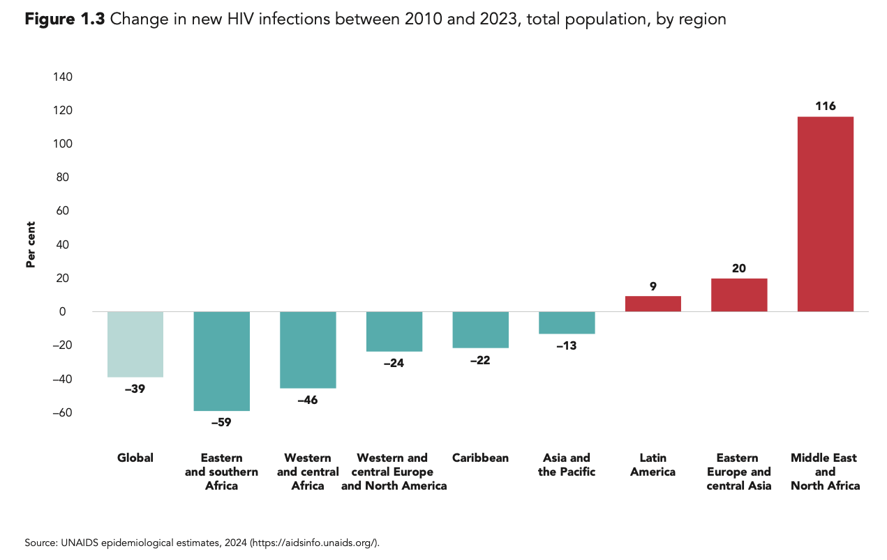
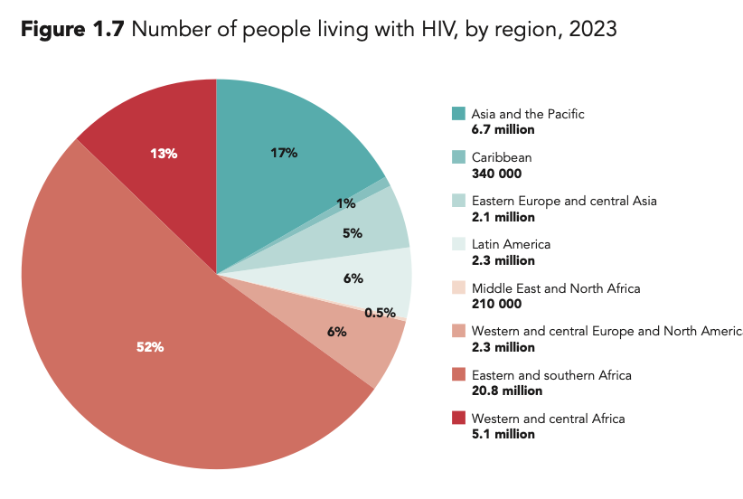
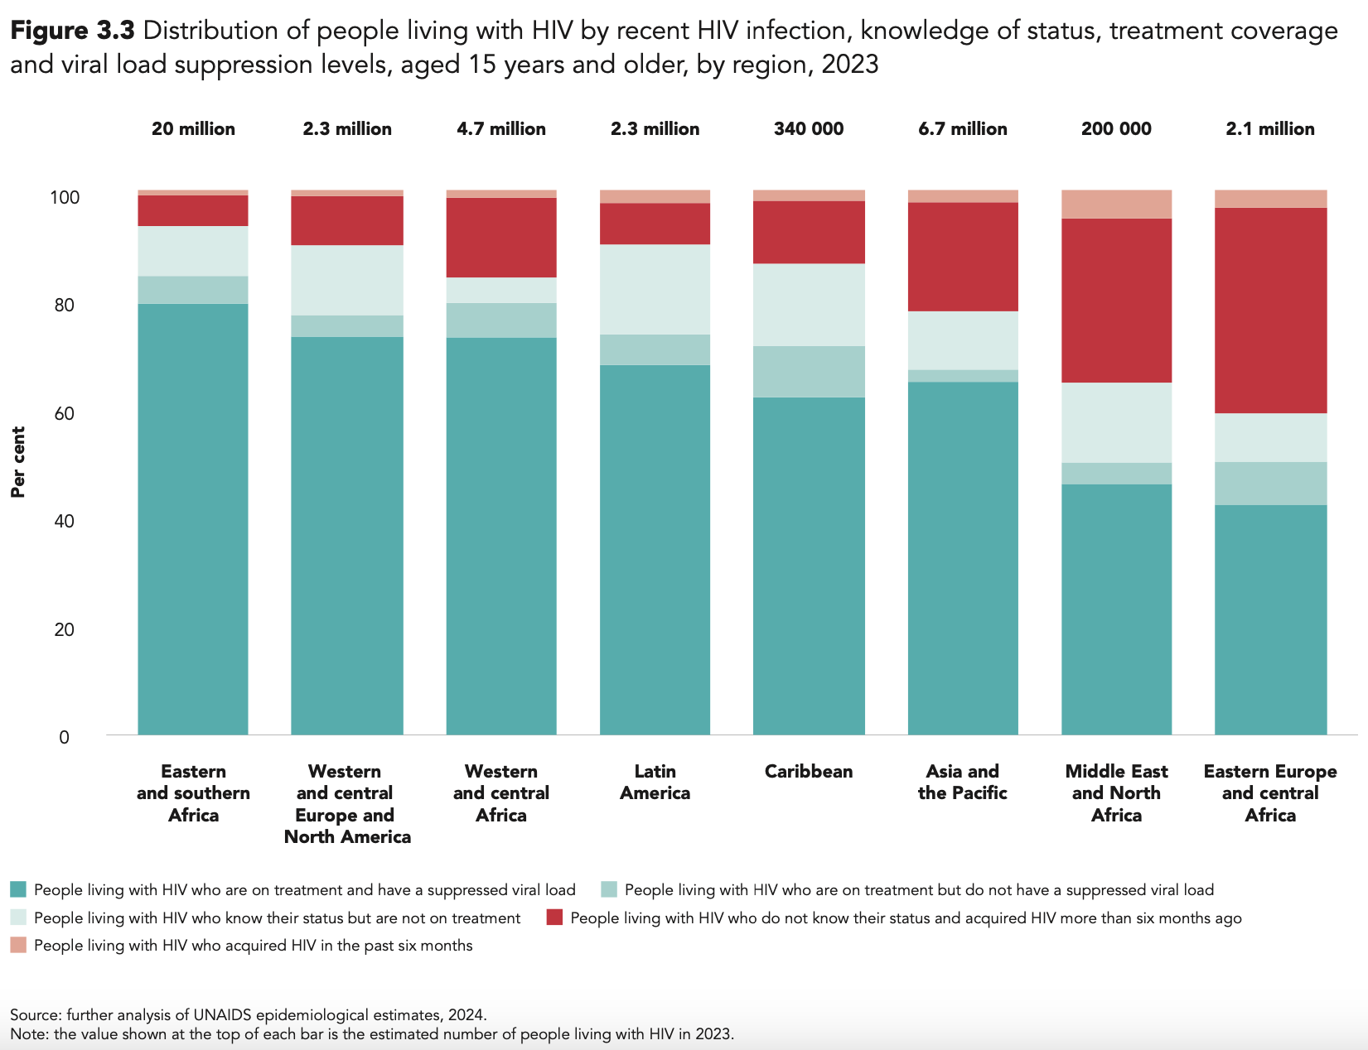
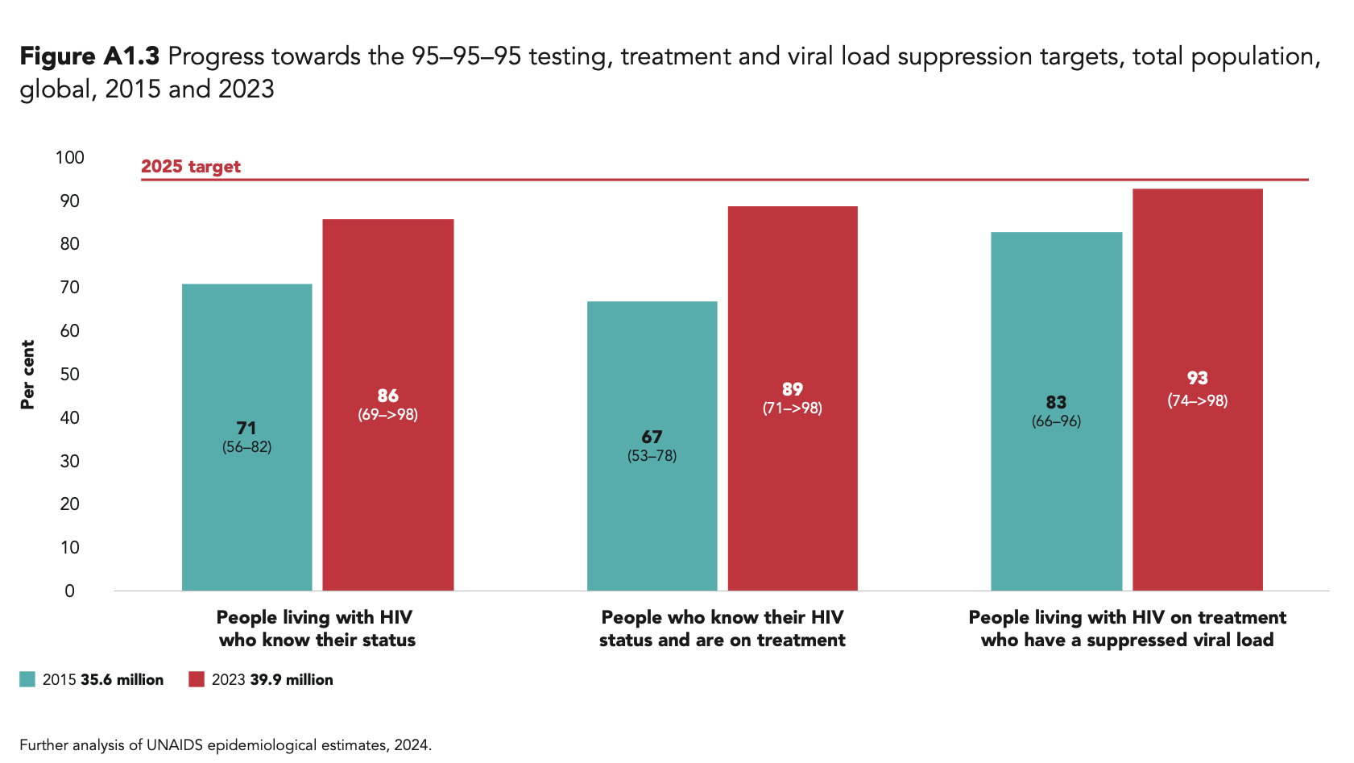
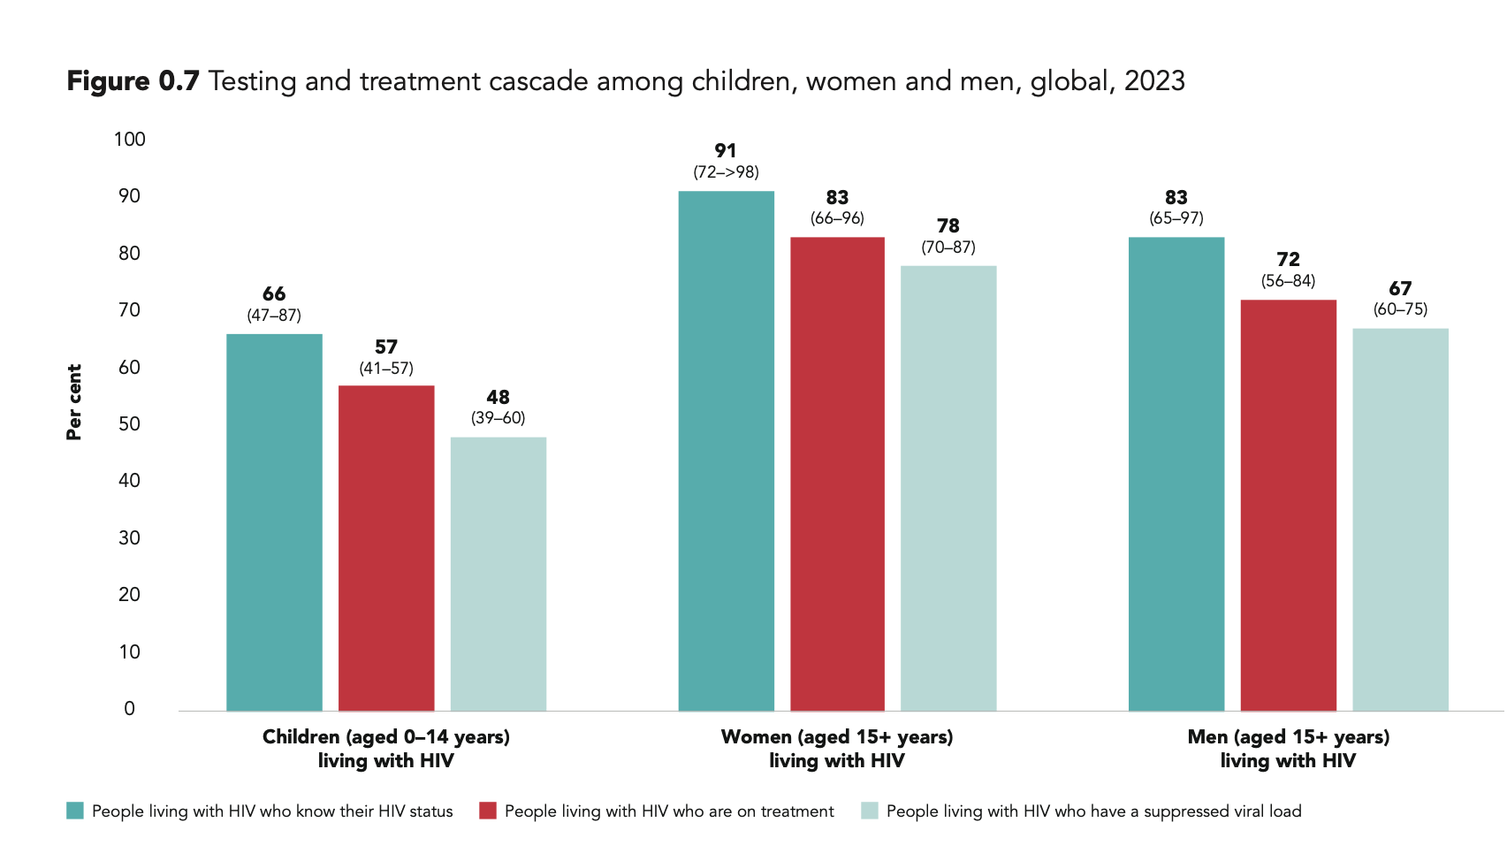
Progress towards the 95-95-95
Global Decline in New Infections
Source: UNAIDS epidemiological report2024 https://crossroads.unaids.org

Slide 4
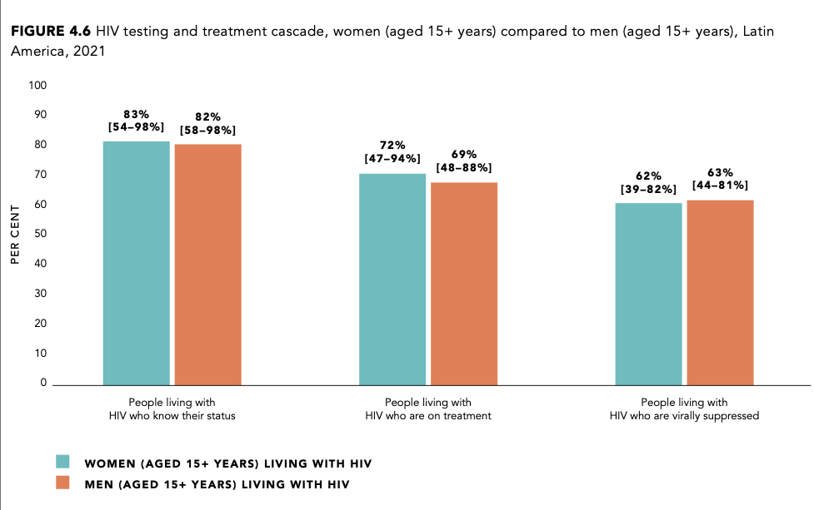
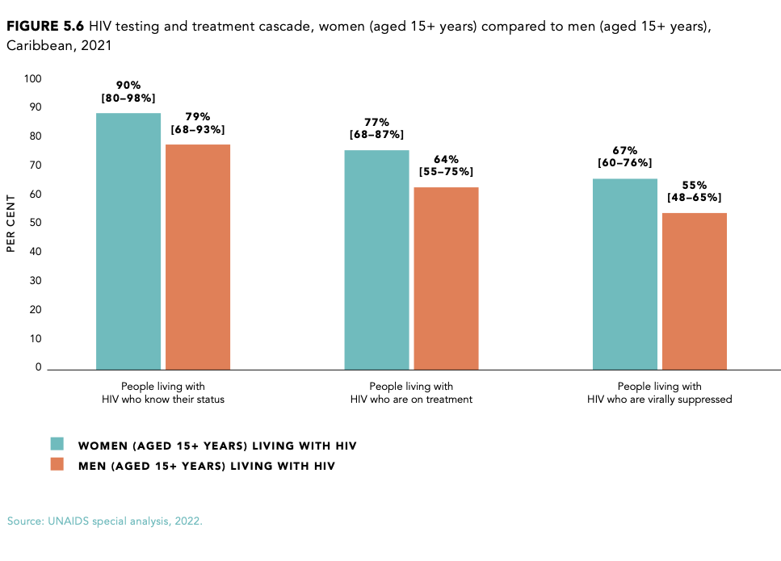
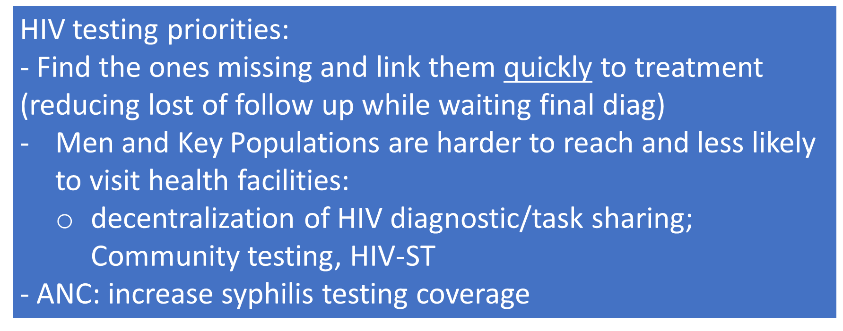
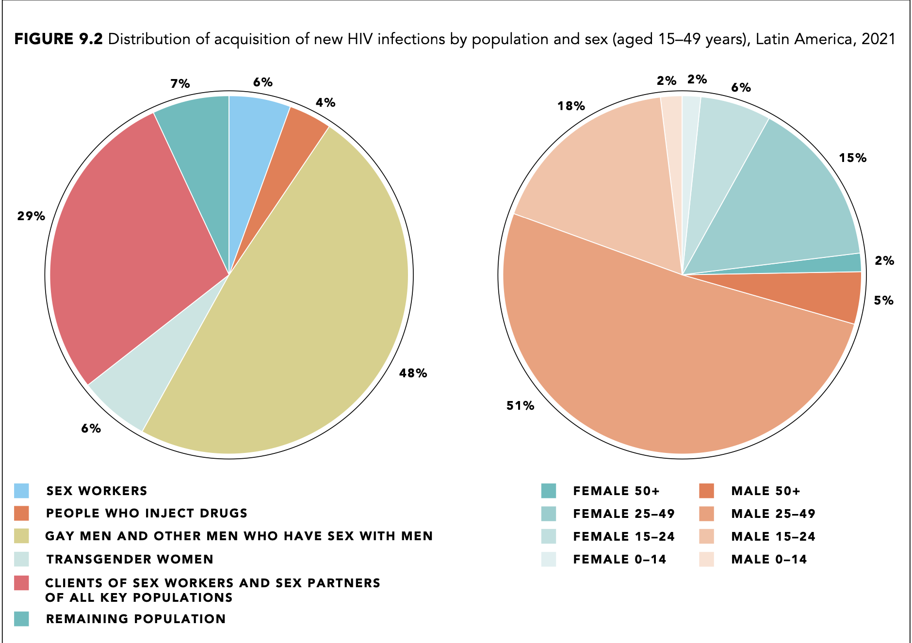
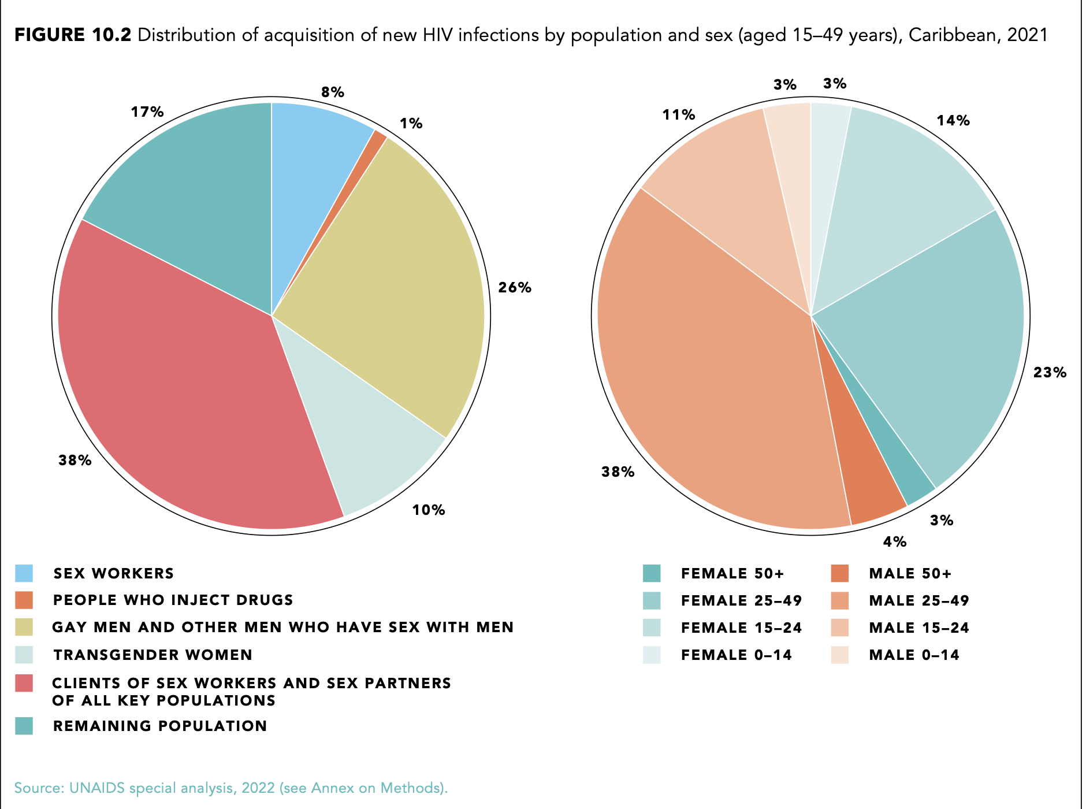
Epidemiological Profile Latin America and Caribbean
Knowledge of status < target

Slide 5
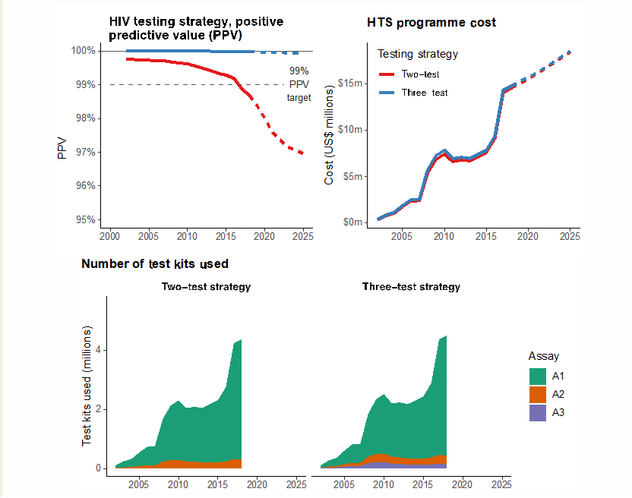
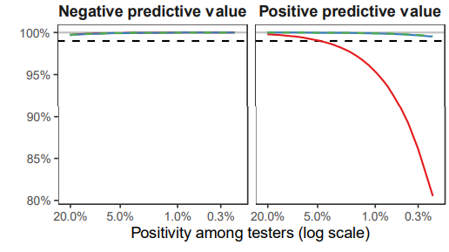
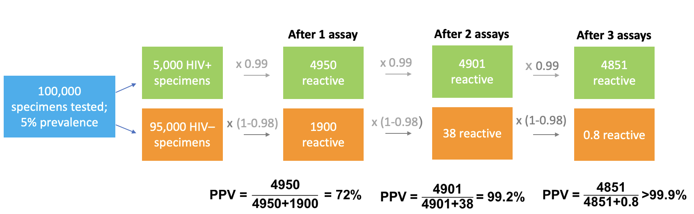

The rationale for the 3-assay testing strategy in POCT
PPV and number of assays
Prevalence among testing population | Per 100,000 tested | After 1 assay | After 2 assays | After 3 assays
10% | 10,000 HIV+ 90,000 HIV- | 9900 true+ (99%) 1800 false+ (2%) 85% PPV | 9801 true+ 36 false+ 99.6% PPV | 9703 true+ 0.7 false+ 99.9% PPV
1% | 1000 HIV+ 99,000 HIV- | 990 true+ 1980 false+ 33% PPV | 980 true+ 40 false+ 96% PPV | 970 true+ 0.8 false+ 99.9% PPV
0.1% | 100 HIV+ 99,900 HIV- | 99 true+ 1998 false+ 5% PPV | 98 true+ 40 false+ 70% PPV | 97 true+ 0.8 false+ 99.1% PPV
The 3-test strategy maintains a PPV of at least 99% for both high and low HIV testing positivity rate settings
COST consideration
The additional third test has a limited impact
The first test in the national algorithm drives costs
JW Eaton - GAM data 2019
Probability of correctly being classified as HIV positive (assuming 99% sensitivity; 98% specificity,
 | After 1 assay
HIV positive specimen | 0.99
HIV negative specimen | 0.02
PPV: outcome per 100,000 tested
Notes:
The lower the positivity rate, the more likely the chance that a reactive test result might be a false reactive.
POC concept. Just because if not it is probably that in the countries extract blood 3 times
This is why I don’t refer to false reactive results but false HIV-positive status.
We constructed a HIV testing strategy that minimizes the potential for a person to be falsely diagnosed as HIV-positive.
As you can see here in the most right column, with three HIV-reactive test results – we have a high PPV over 99% FOR BOTH HIGH and LOW positivity rate.

Slide 6

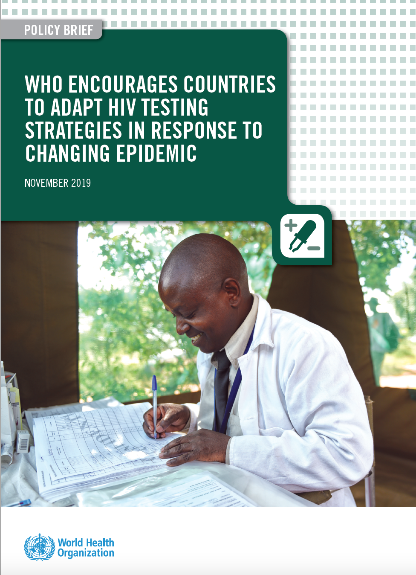

Adapting national HIV testing strategies
.
Ensure that the testing strategy has a positive predictive value ≥99% (PPV)
  Meaning of the persons classified as HIV+, ≥99% will truly be living with HIV
  PPV and NPV depend on the positivity rate among the testing pop
**Simplified algorithm Consecutive HIV tests only
WHO recommends all countries currently using two consecutive reactive tests for an HIV-positive diagnosis move toward using three consecutive reactive tests for an HIV-positive diagnosis. This is increasingly important as treatment-adjusted HIV prevalence and national HTS positivity continue to decline over time.
Quality-assured assays, such as WHO prequalified, should be used:
  >99% sensitivity: fewer than 1 ‘false negative’ for 100 truly positive
  >98% specificity: fewer than 2 ‘false positives’ for 100 truly negative
  Either rapid diagnostic tests (RDTs) or immunoassay (EIA, CLIA, ECL)
Confirmation of HIV infection = combination of 3 “reactive” IA/RDT results
(not an individual confirmatory test)

Slide 7
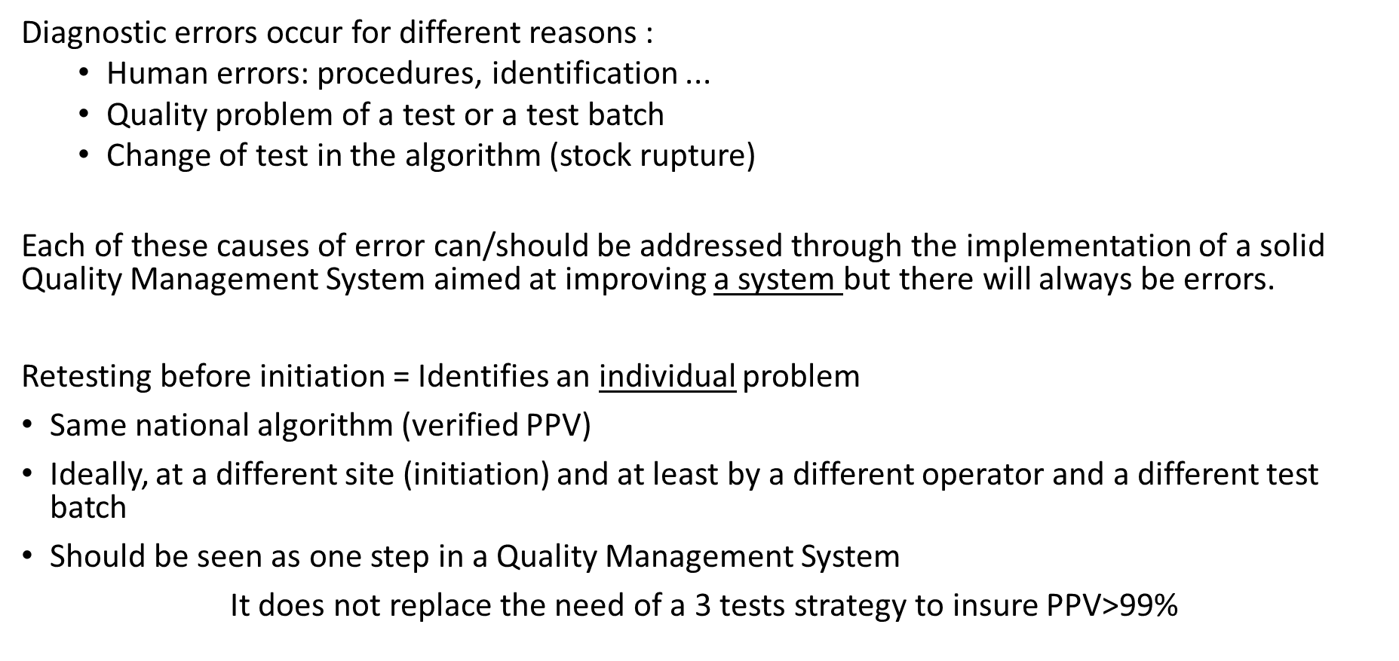
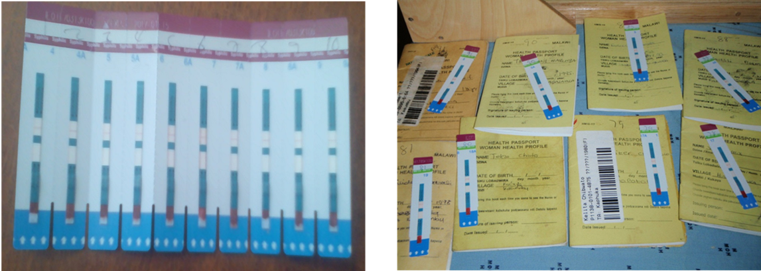
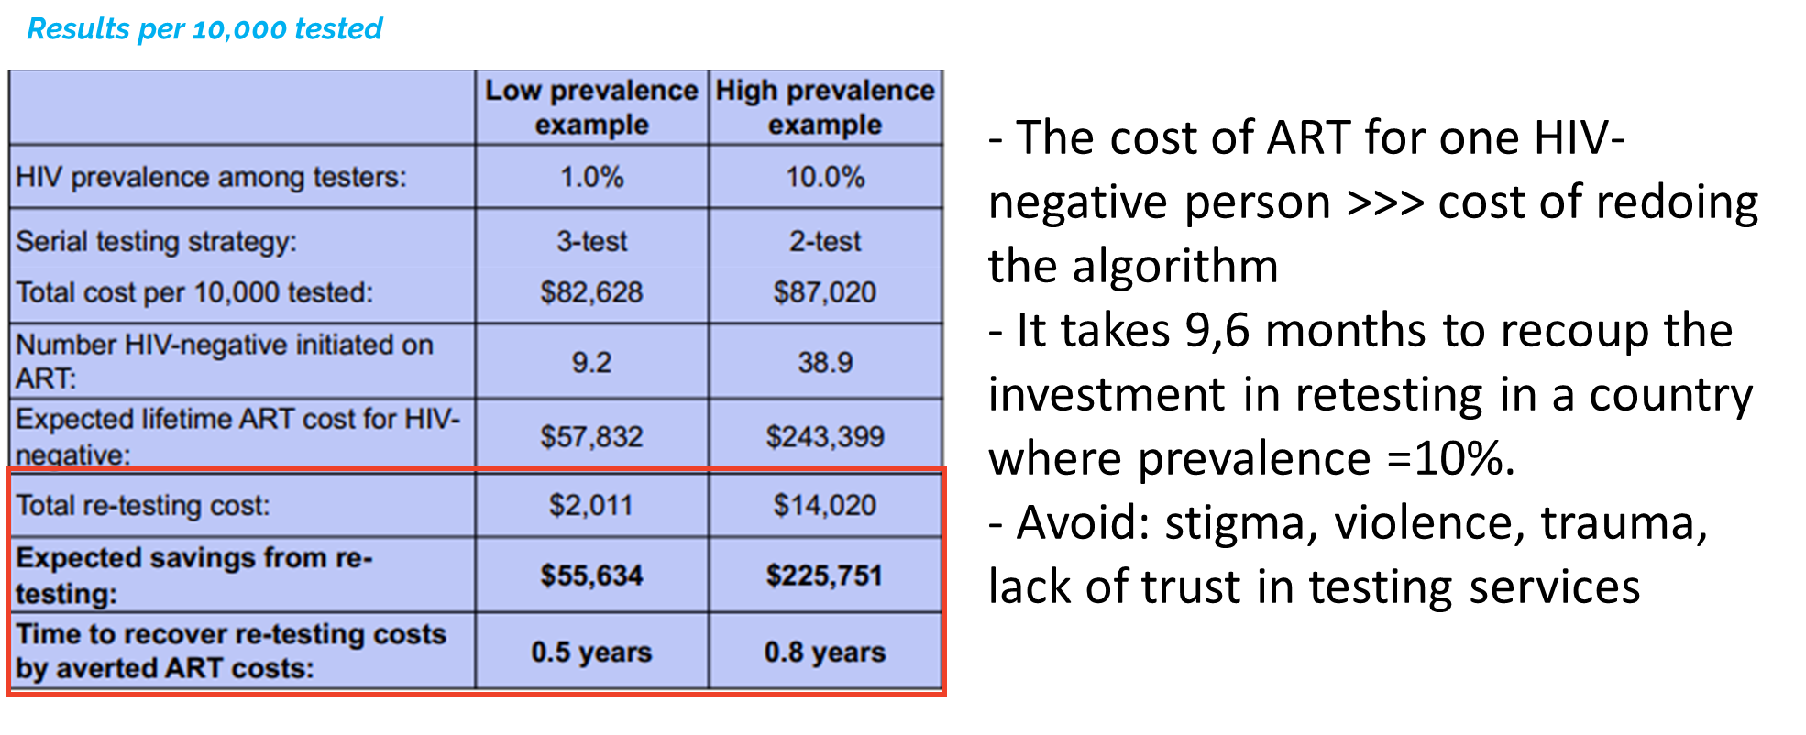
Each new HIV-diagnosed person should be retested prior to ART initiation- WHY?
Re-testing costs and ART costs for misclassified HIV-neg adults

Slide 8
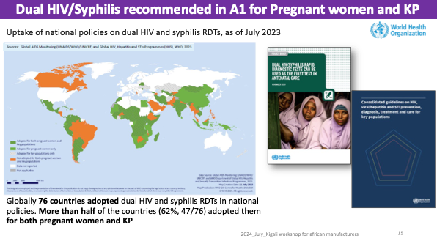
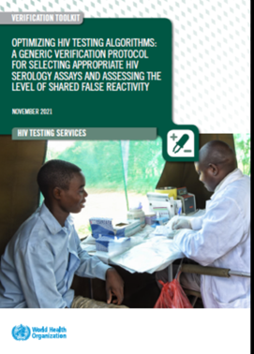
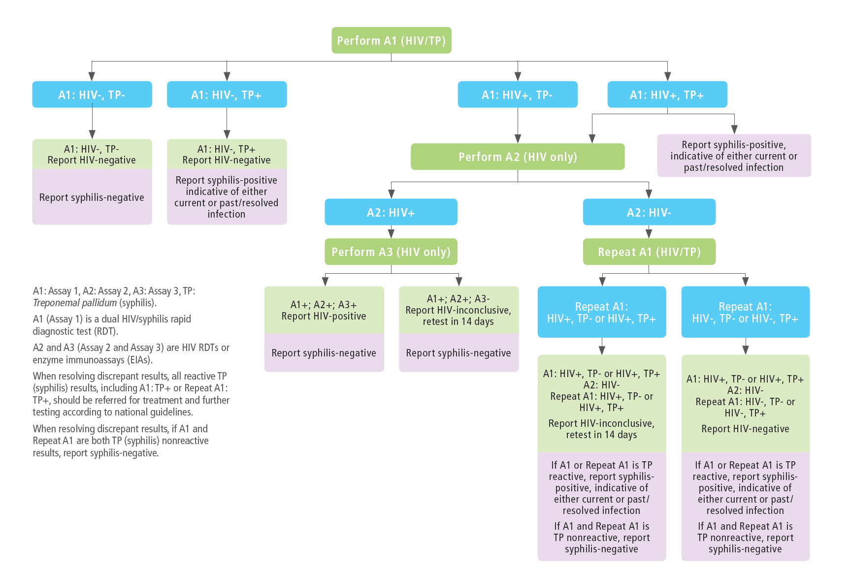
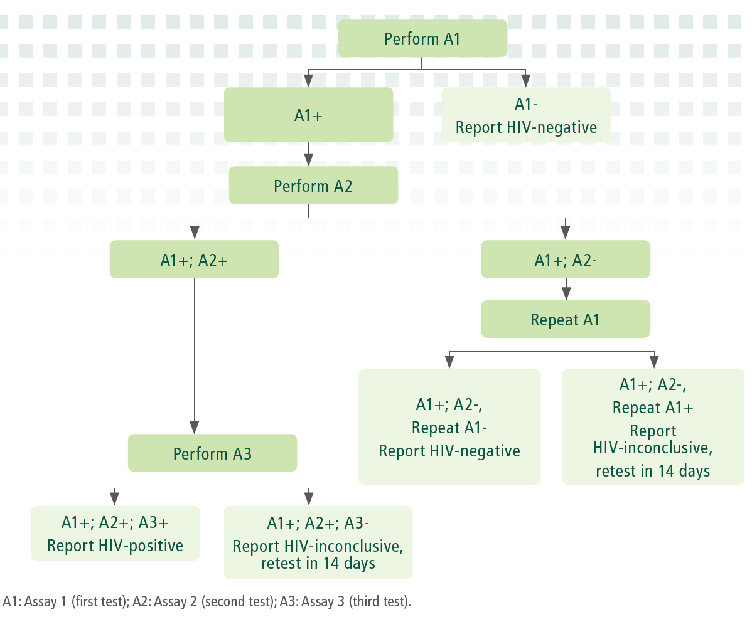
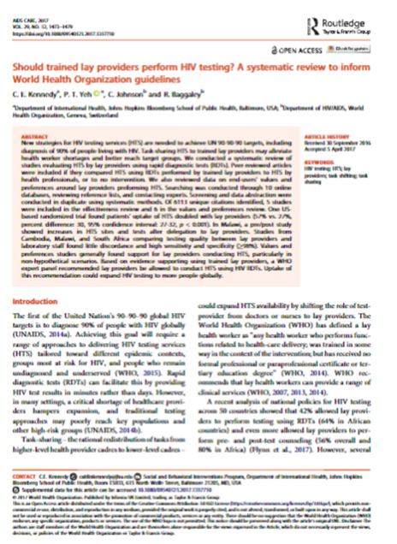
WHO recommendations on HIV testing strategy for people >18 months
Standard 3-test strategy
End WB /IB
Toolbox:
Verification
study
RDT DUO HIV-Syphilis in ANC (and KP) contexts
ANC and key pop contexts: HIV-Syphilis Dual test in A1
Screening by community agents
Gen pop: HIV only
Notes:
We're going to have a session specific on this so I will not expand on it but these recommendations are still current and are very important to ensure the correct diagnosis of people

Slide 9
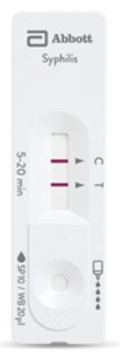
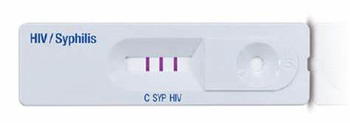
Opportunity to address the two epidemics together
The use of dual HIV/syphilis RDTs and Syphilis self-test
Benefits of dual HIV/syphilis rapid testing
potential to leverage syphilis screening and linkage to care to the level of HIV coverage and treatment initiation
can be performed by any trained health worker
potential to expedite partner services and to be used as part of network testing strategies
reduced unit cost compared with two single RDTs for HIV and syphilis
streamlined procurement and minimized storage s
WHO recommends that pregnant women receive screening for HIV, syphilis, and hepatitis B ( HBsAg ) at least once during pregnancy, preferably during the first trimester). Dual HIV/syphilis rapid in ANC and services reserved for key populations (A1)
[NEW] WHO suggests to offer a Syphilis self-test as approach additional syphilis diagnosis ( conditional recommendation , low certainty evidence )
New features and updates (released July 2024)

Slide 10




Expanding self-testing
WHO guidance on HIVST-supported PrEP
Self-testing is safe, effective, and empowering
  Recommended across conditions and diseases including HIV, HCV, and syphilis – including dual HIV/syphilis self-tests,
  HIV self-testing can be offered as an additional testing option in health facilities Affordable WHO-prequalified self-tests are available ($1),
  ST is used in facilities, communities, pharmacies, and through partners, peers, and networks in more than 100 countries
New
HIVST recommended for expanding prevention
  PEP delivery – at start and completion
  HIV self-testing can be used for the delivery of pre-exposure prophylaxis, to initiate, reinitiate, or continue it (conditional recommendation, low-reliability data). ongoing research needed
  Greater access, many benefits, lower costs
  No risks of increasing drug resistance at the population level
  Choice advised - oral and blood-based ST are both acceptable
We need HIVST to increase PrEP access and reach the 10 million users needed to achieve global prevention goals by 2025

Slide 11




country uptake of the new recommendation on HIVST-supported PrEP
As of May 2024, WHO mapped and identified the following country reports (work ongoing).
Product name | Manufacturer | Sens (%) | Spec (%)
CheckNOW HIV SELF TEST | Abbott Rapid Diagnostics Jena GmbH former Alere Technologies GmbH | 99.5 | 98.5
INSTI HIV Self Test | bioLytical Laboratories | 100 | 99.7
Mylan HIV Self Test | Atomo Diagnostics Ltd | 99.8 | 99.8
OraQuick HIV Self-Test | OraSure Technologies, Inc. | 99.1 | 99.8
SURE CHECK HIV Self-Test | Chembio Diagnostic Systems Inc. | 99.8 | 99.9
Wondfo HIV Self-Test | Guangzhou Wondfo Biotech Co., Ltd | 100 | 100
HIVST for
PrEP demand creation
HIVST for
PrEP initiation
HIVST for
PrEP re-initiation
HIVST for
PrEP continuation
Nepal, Zimbabwe, Kazakhstan, Ghana, South Africa, Eswatini & Viet Nam
Philippines, Eswatini
& Thailand
Brazil, Thailand & Eswatini
Zambia, Spain, Mozambique, Kenya, South Africa, &
Viet Nam
New features and updates (released July 2024):
Accuracy, sensitivity and specificity of self-tests

Slide 12
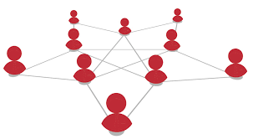
What are network-based screening approaches?
New terminology proposed:
Network-based approaches:
Update: Network-based testing approaches may be offered as complementary approaches to HIV testing as part of a comprehensive package of care and prevention.
Partner services for STIs should be offered to people with STIs according to their needs and preferences and as part of a comprehensive package of voluntary STIs.
Provide options based on client needs (partner referral, provider-assisted, expedited partner therapy*)
Services must always be voluntary
Network-based screening approaches
Partner Services
Social media-based screening
Intra-family and home
Social network testing now for all with risk (not only key populations)
  ST, community-led, multiple rounds
  Virtual or in-person
  No need for incentives or in-depth training
What are network-based testing services?
testing, as well as offering prevention and treatment, by supporting individuals to disclose to, refer for testing, and/or distribute self-tests to partners, families, and other members of their social networks.
Recommended across HIV, viral hepatitis, and STIs
Prioritize and integrate services
  Prioritize and integrate based on capacity and resources
  Support prevention – like PrEP for partners
  Consider dual HIV/syphilis RDT/ST
  Strategic opportunities with ANC, male partners, KP
  HIV and HBV within family and household outreach
*EPT is only an option for curable STIs
Notes:
now turn to network-based screening approaches to tell you that we have changed the terminology
They are grouped under this term:
Partner Services​​
Social media- based screening
Intrafamily and home

Slide 13
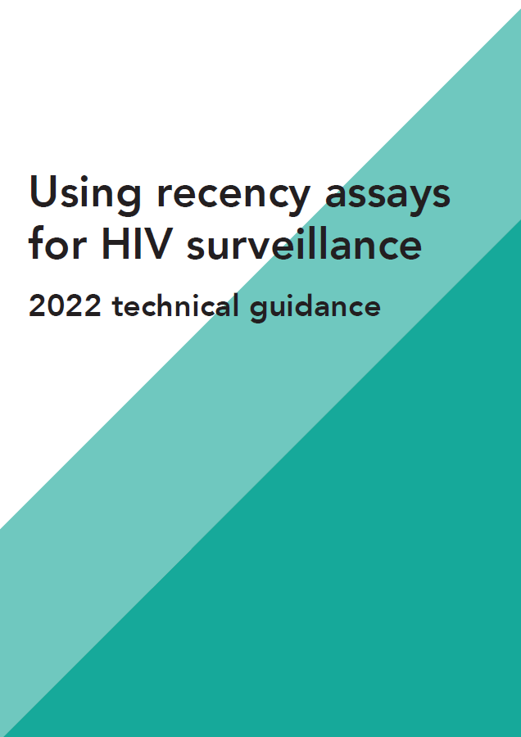
WHO does not recommend the use of tests for recent infection in HTS
No benefit to using tests for recent infection in routine HIV testing services,
WHO recommends the use of recent infection tests in surveillance activities
No study showed clear evidence of effectiveness or clinical benefit
Caution: Their use in routine services only:
when HIV testing coverage is high in the population studied,
Additional tests necessary to reduce recent false results (e.g. viral load),
Uncertain effects on social harm
Concerns remain such as fear of stigma, conflict among community members, dissatisfaction with services, and increased intimate partner violence were reported by providers and clients.
Need to prioritize limited HTS resources toward impactful approaches
Limited feasibility due to requirements for substantial resources, time, planning, training, and monitoring
High costs do not replace diagnostic testing and require additional tests and service costs (test kits, VL, implementation).
Concerns about reduced equity due to diversion of funds
Remarks
This recommendation calls for excluding tests for recent infection from HIV testing services.
Tests for recent infection can, however, be used as part of the HIV surveillance.
WHO has published guidance on this in Using recency assays for HIV surveillance: 2022 technical guidance. ( https://apps.who.int/iris/rest/bitstreams/1486096/retrieve
No recent infection tests are currently being carried out by PQ-WHO and no pathway for recent infection testing to be PQ-WHO
Recency for surveillance
Notes:
Infection tests recent are complex and have demonstrated their usefulness in monitoring activities to more easily measure the incidence . He must or used in a population where screening coverage East high and be used within an algorithm (RITA) which includes also tests to reduce the number of misclassification “ recent infection ” such as CV and adjustments statistics are necessary to deduce trends within the population studied ( see WHO guideline).
However the use of infection tests recent in context routine programmatic​ watch none advantage is​ Why Testing for recent HIV infection is not recommended as part of routine HIV testing services.
There are no prequalified tests, none in prequalification and there is no path to being PQ because PQ only concerns diagnostic tests/ methods
The prior guidance stated: WHO does not recommend the use of recency assays for clinical use or management of people living with HIV or their partners. In this context, this includes return of results to clients; counseling messages about recent infection; and prioritizing initiation of antiretroviral therapy, partner services, index testing or additional services based on recency results

Slide 14

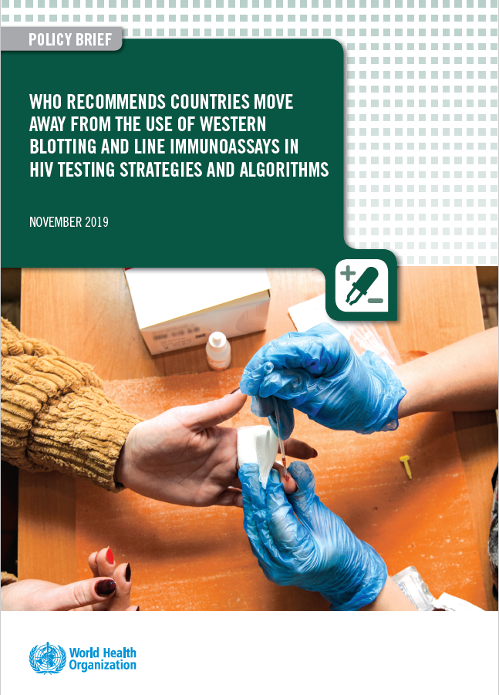

Better uptake & preferred by clients (especially KP) = more people know their status
Lay provider vs HCW: 57% vs 27% (95% CI: 27–32,p< .001)
In all studies, individuals preferred RDTs over lab-based methods (EIA & WB)
Low cost & affordability
Using lay providers is less costly and more feasible across HTS sites
Using RDTs is less costly overall & shown to be cost-saving compared with laboratory methods
Accurate diagnosis
Lay provider HTS equivalent accuracy to HCWs RDTs and equivalent to laboratory methods (EIA/WB)
Fewer indeterminate/inconclusive results = easier messaging & more people able to start ART and PrEP faster which is key
Labs still have important work to provide support & supervision for HTS – shifting to RDTs and lay providers doesn’t take but adds to their work
Same day start
RDTs have a much faster turnaround time than lab-based testing
RDTs enable the decentralization of confirmation testing which is a key
People get to start PrEP & ART on the same day - reducing the loss of follow-up
Many countries (mainly in ESA) have reached or are near to reaching the 1st 95 and 2nd 95 – RDTs made it possible (task sharing, decentralization)
Why lay provider testing and rapid testing in POCT?
Source: Wagner 2023; Derksen 2015; Kennedy 2017; WHO 2019

Slide 15
NAT and HIV infection confirmation
for adults and children >18 months (1/2)
.
Questions on potential use cases for NAT in HIV testing algorithms but some cautions (WHO is looking for the program using NAT data):
  NAT tests should claim “aid to diagnosis” as part of their IFU so they can potentially be used in testing algorithms. If not: “off-label use”. Quantitative tests(VL) are designed and regulated for monitoring not aid in diagnosis
  An undetectable NAT does not mean HIV neg: people on ART and PrEP might have an undetectable NAT test (in some settings, 30-50% % of people attending testing sites already know their status and are on ART-next slide)
  NAT to confirm HIV status (after 2 reactive serology tests):
    NAT reactive = confirmed HIV infection
    There is a high probability that a third serology test would reactive as well (less costly and reduce TAT compared to NAT)
  NAT to resolve inconclusive status (discordant A1, A2 or A3 results):
    NAT reactive = confirmed HIV infection
    Undetectable NAT does not mean HIV neg. so the final result would still be inconclusive and need additional testing after 2 weeks (same outcome as serology)

Slide 16
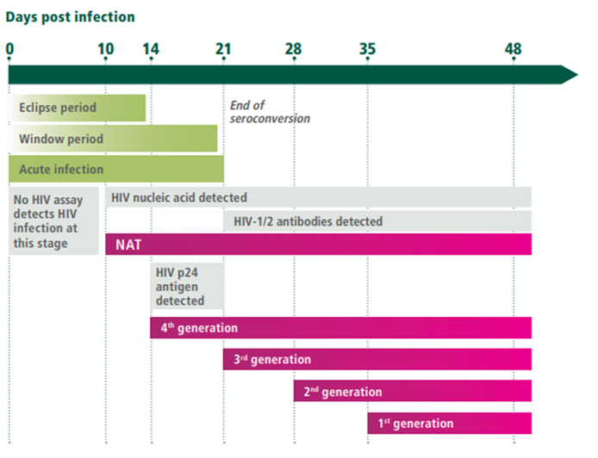
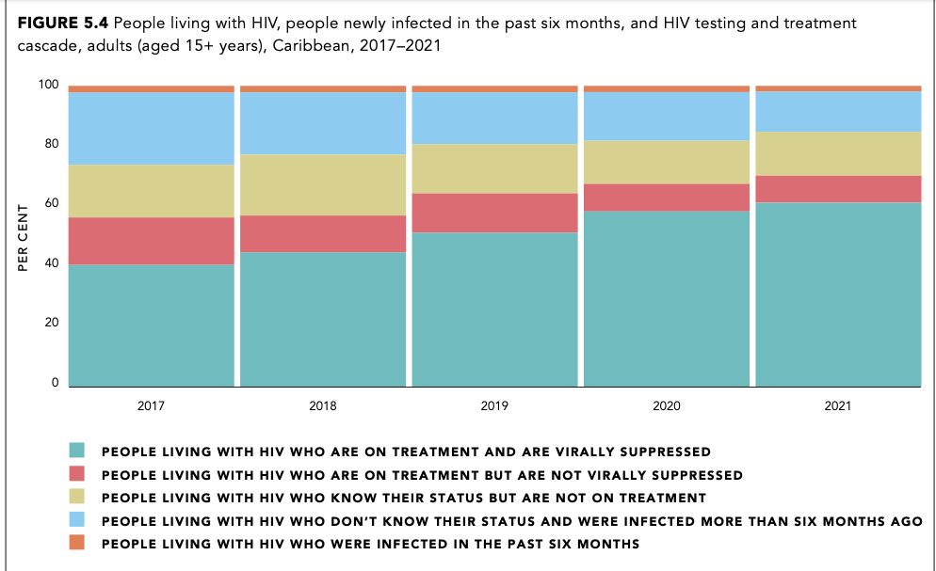
NAT and HIV infection confirmation
for adults and children >18 months (2/2)
.
3. NAT to find acute infection:
Latin America:
3rd generation Ab tests (IA and RDTs) detect from 21 days
4th generation Ab/Ag tests (IA and RDTs) detect from 14 days
NAT detect from 10 days (4 days before 4th gen and 10 days before 3rd gen
PLHIV infected >6 months
Caribean:
Rosenberg and all, 2015
Added value of NAT (but also 4th gen Ab/Ag) depends on the proportion of clients attending testing sites before 3rd generation tests become reactive: context-dependent
To balance with the need to increase access to testing to close the gap in 1st 95
Increase in False-Positive Fourth-Generation Human Immunodeficiency Virus Tests in Patients With Coronavirus Disease 2019 | Clinical Infectious Diseases | Oxford Academic (oup.com)
Notes:
most of the undiag people have been infected more than 6 months ago

Slide 17
Process to update National HIV testing strategy and algorithms
Review of a product dossier
1st step: selecting quality-assured products: eg: WHO Prequalified IVDs
Performance evaluation
A comprehensive assessment of individual IVDs through a standardized procedure
The aim is to determine if the product meets WHO prequalification requirements
The full prequalification assessment process includes three components:
Manufacturing site inspection
WHO recommends to use of only quality-assured products: HIV assays that have undergone stringent regulatory assessments (product & manufacturing)
34 different WHO PQed assays available for procurement:
22 HIV RDTs:
All meet WHO’s standards for at least 99% sensitivity and 98% specificity
4 EIAs
Dual HIV/Syphilis RDTs:
3 products available for procurement & low cost
6 HIV-ST:
1 Oral fluid and 5 blood based
Performance characteristics
Highest sensitivity (to rule in all positives [true + false]) | A1
Highest specificity (>A1) (to rule out all false positives) | A2 and A3
Correctness of the final HIV status is dependent on:
  Specificity of the individual products used (for A1, A2, A3), and
  The probability that any specimen that is falsely reactive on the first assay (A1) is not also falsely reactive on the second assay (A2) and third assay (A3) – this can vary by region/country
Source: https://extranet.who.int/pqweb/vitro-diagnostics/prequalification-reports/whopr?field_whopr_category_tid=58

Slide 18
Principles for the selection of HIV testing Algorithms
It is suggested to conduct a verification study of the new testing algorithms to:
Identify the combination of products that have minimum possible common cross-reactivity to reduce the risk of false HIV-positive diagnosis. (Note: Products from the same manufacturer should not be used as part of the testing algorithm to minimize common cross-reactivity)
Identify flexible algorithms: replacement tests in case of a "problem" with one of the selected tests, e.g. stock out, lot recall, etc. One for A1 and one for A2/A3
Not intended to reevaluate the sensitivity and specificity of individual products!
Empower the National Programme to choose their products
To be familiar with the products that their programs will use
Product Pre-selection tool for: HIV standalone tests (RDTs and EIA) and HIV/syphilis dual RDTs
  Performances characteristics: Sensitivity, specificity, subtype detection, invalid rate….
  Operational criteria: shelf life, storage conditions, ease of use, result stability, packaging ….
  Cost: The price included in the tool is the WHO-negotiated price (to be checked in the country)
  Weigh (in order of importance) these criteria according to local context (users, climate, procurement system…) and preferences
  Choose 10-12 tests for the verification study:
  At least 4-5 for A1 (Sen>99%) and 5-6 for A2/A3 (Spe>99% and >A1), different brands
  Include dual HIV-Syphilis RDTs for ANC and eventually KP settings
Choose verification study characterization tests : 1 RDT (not intended to be included in the national algorithm)
  1 EIA (prefer EIA already used by the reference lab)
Shortlisting candidate assays based on
Performance and operational characteristics

Slide 19
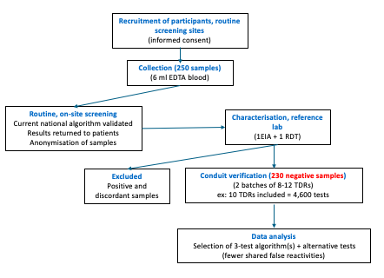
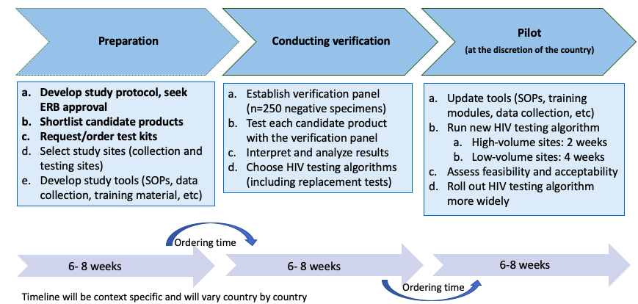
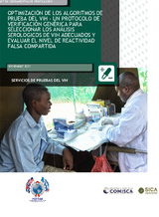
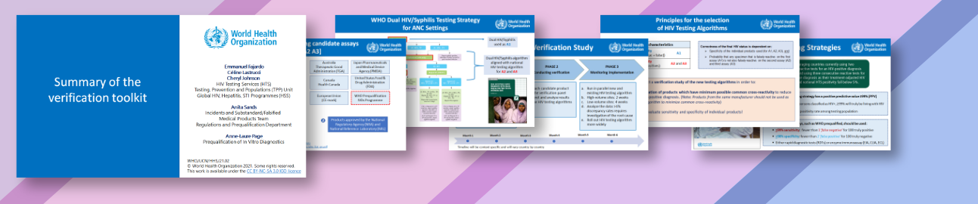

Algorithm transition process and available tools
Algorithm Transision Process:
Verification study diagram:
Algorithme verification tool kit: available in spanish
Test 2 batches of 10-12 candidate products on a panel of 230 negative specimens and identify the best 3 test combination(s) + 2 replacement tests
- Assess level of shared false reactivity of standalone HIV and dual HIV-Syphilis tests
Cross sectional laboratory study
Clinical specimen collected prospectively from individual attending routine HIV testing
(source: https://www.who.int/tools/optimizing-hiv-testing-algorithms-toolkit)

Slide 20
In the end: Preparing for Implementation
Run new 3-test algorithms for 1 month
(in selected low-volume and high-volume sites)
Small scale implementation
In a routine context: check everything is ready for national scale-up
Build users’ proficiency and confidence
  Update supportive tools: SOPs, bench aids, training modules, ordering sheets, data collection, and reporting materials (registers…)
Assessing feasibility :
  Turn Around Time for the same day result
  Pre and post-training questionnaires
  Compliance using onsite witnessing (supervision checklist)
  Review of testing statistics: pos rate, discordant rate, invalid rate
  QC results (proficiency testing)
  Review M&E reports at national level, stock control…
Assessing acceptability:
  Provider-perspectives one ease-of-use of new HIV products (questionnaire) and algorithm interpretation
Lessons learned: Implementation recommendations: what changes and improvements are needed to make scale-up go faster, with more quality and efficient
Country decision-making process: Some countries decided to continue using the same tests (continuity/training purposes), and some took this opportunity to change (interesting new tests, boosting the market, cost saving)
Procurement delays: identify the best option possible for your context
Assess feasibility and acceptability
Share lessons learned
Adapt local policy
Register products
Scale up

Slide 21

Acknowledgements
.
Rachel Baggaley, Maggie Barr-DiChiara, Cheryl Johnson, Anita Sands, Celine Lastrucci, Anne Bekelynck, Purvi Shah, Carlota Baptista Silva, Anna Elizabeth MONROE-WISE, All other partners for permission to use slides
For more information on HIV testing services
WHO HIV Testing Services Dashboard
WHO HIV Testing Services
Info App
WHO HTS GL
Questions?
Alaleh ABADPOUR abapour@who.int
Céline Lastrucci lastruccic@who.int
21

Slide 22
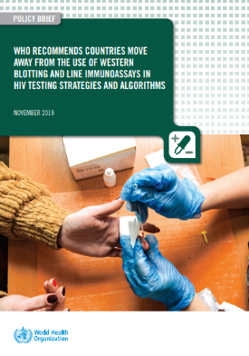

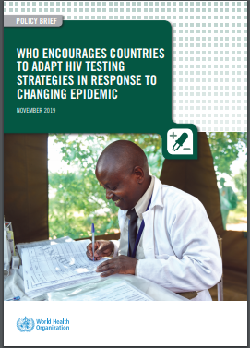
Tools and guidance
WHO policy briefs:
WHO encourage countries to adapt HIV testing strategies in response to changing epidemic
Dual HIV/syphilis rapid diagnostic tests (RDTs) can be used as the first test for pregnant women as part of antenatal care (ANC).
WHO recommends countries move away from the use of western blotting and line immunoassays in HIV testing strategies and algorithms
L’OMS recommande un autodépistage du VIH – mise à jour des données probantes et clés du succès
Notes:
For policy makers who need advocacy materials that state the new recommendations and their rationale.
We have developed specific targeted policy briefs.

Slide 23
More tools and guidance
Annexes to WHO HTS guidelines:
Annex D - GRADE Table: Should western blotting and line immunoassays be used in national testing strategies and algorithms?
Annex E - Abstract: Performance of HIV testing strategies: considerations for global guideline development
Annex F - Abstract: Modelling the cost-effectiveness of maternal HIV retesting in high- and low-HIV burden settings
Annex G - Abstract: Modelling the cost-effectiveness of using HIV/syphilis dual tests in antenatal care in high and low HIV burden settings
Notes:
For those of you who like more details and the science behind the recommendations, there are a number of supportive annexes to the guidelines that are available as stand-alone web links.
These include the GRADE table of evidence that was reviewed by the guidelines development group on the use of western blotting and line immunoassay, as well as modelling of the cost-effective of introducing dual RDTs for HIV/syphilis in antenatal care settings.

Slide 24
additional slides

Slide 25

Verification tool kit description
.
Verification tool kit: set of tools to support implementation of the verification study
(https://www.who.int/tools/optimizing-hiv-testing-algorithms-toolkit)
  Generic study protocol: to assist developing local protocol to seek ethics approval
  Product selection tool: to assist with the selection of WHO prequalified HIV products
  Gantt chart: to assist with the planning of the verification study with timelines
  Budget template: to assist developing a budget of core activites
  Order checklist: of tests and consumables to be purchased
  Study data base: to assist design of data collection tool to collect test results (characterization and testing phase)
Available in English, Spanish French and Russian

Slide 26


Conducting the verification study
.
Verification Panel (n=230)
Data analysis
RDTS (n=10-12)
1
1
1
1
1
1
1
1
1
1
1
1
1
1
1
1
1
1
1
1
1
1
1
1
Identify the products displaying the lowest false reactivity
Identify the products sharing the least number of false-reactive results
Choose HIV testing algorithms for the general population and ANC settings, if applicable (same A2 and A3 preferred)
2 replacement tests
Specimen Number | A1 | A2 | A3 | A4 | A5 | A6 | A7 | A8 | A9 | A10 | Total assays sharing false- reactive results
001
002
003
004
005
006
007
008
009
010
Total specimens showing false- reactive results

Slide 27
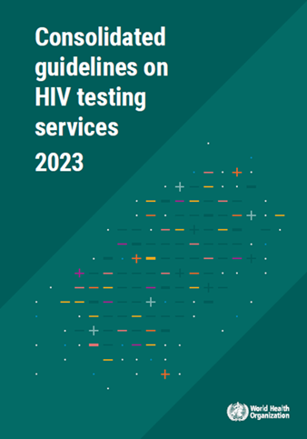
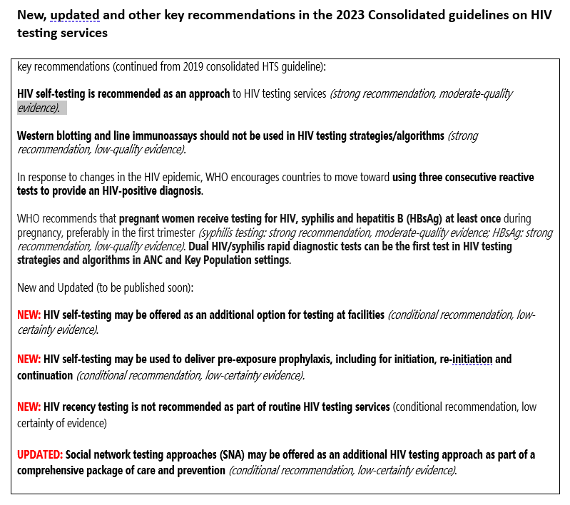
Latest WHO guidance on HIV Testing Services
7

Slide 28
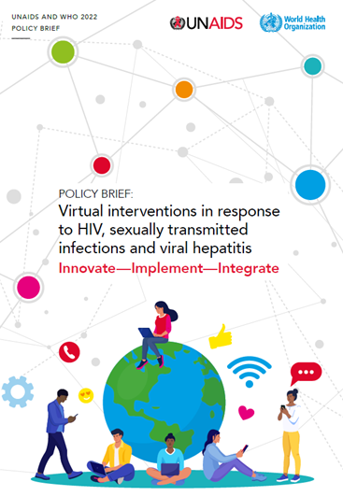
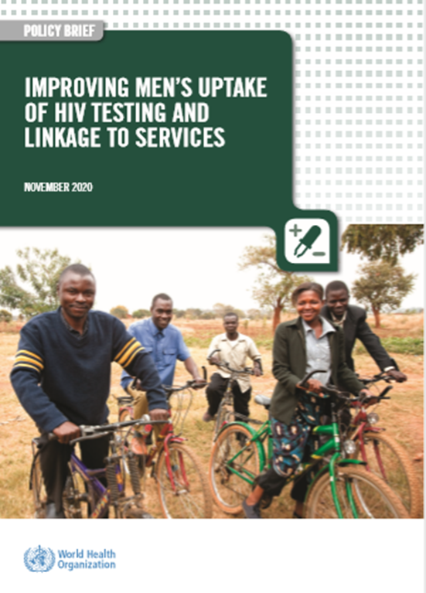
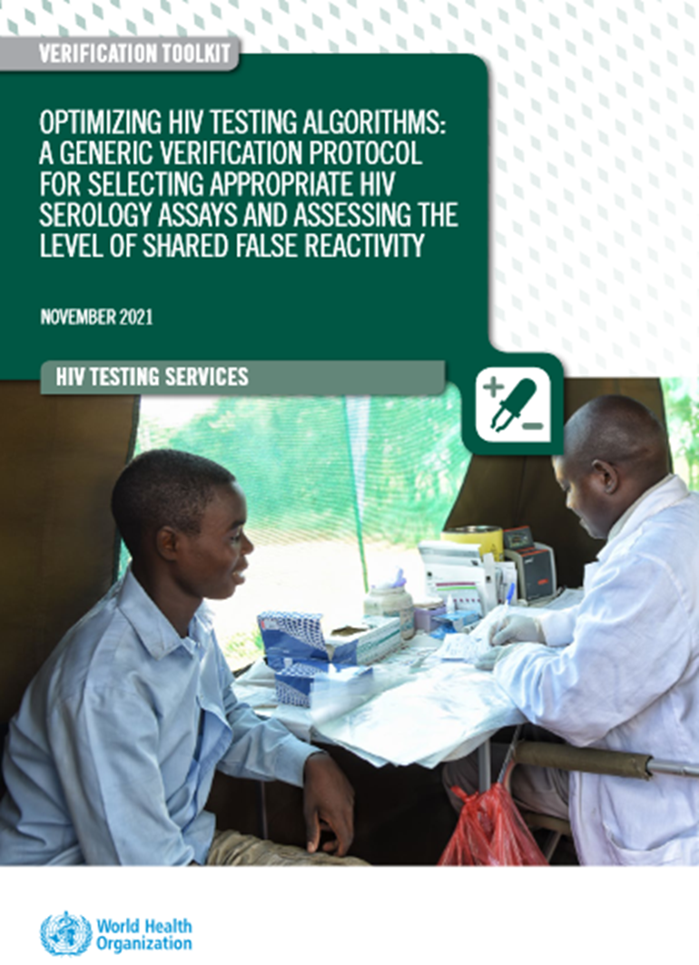
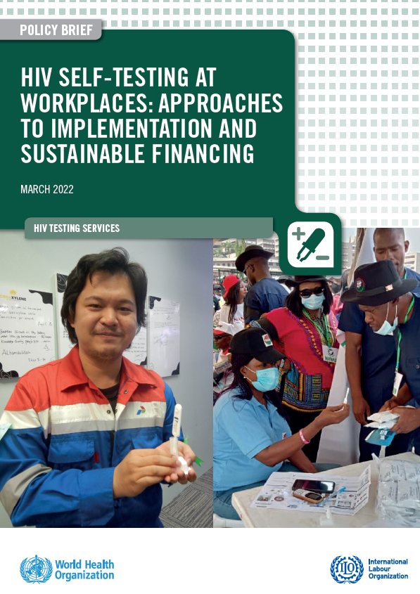
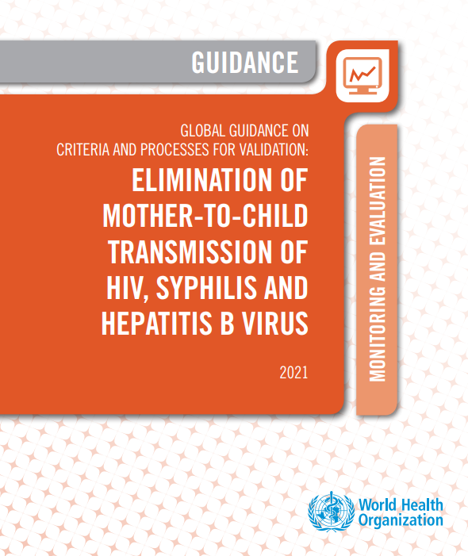
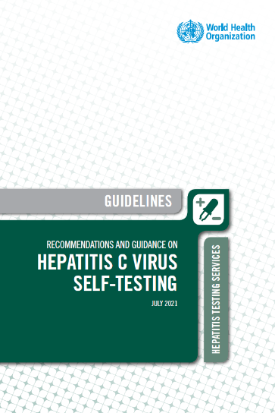
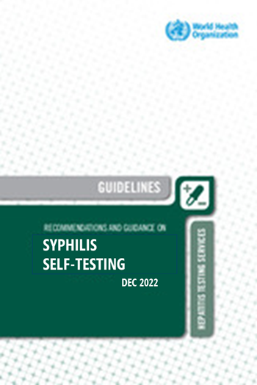
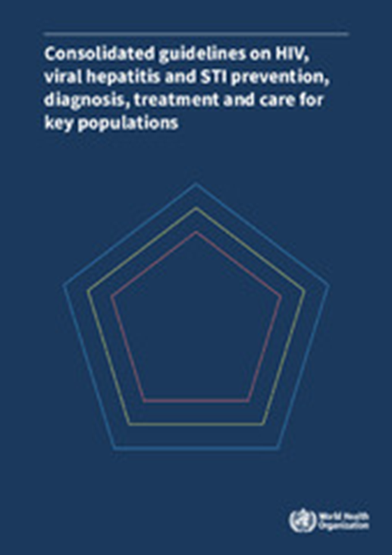
WHO guidelines on Testing Services
Other testing updates
HIV algorithm verification toolkit (2021)
Virtual intervention (policy brief 2022)
Key populations (KP guideline 2022)
  Optimal retesting frequency
  Dual HIV/syphilis RDT
Triple EMTCT : HIV, Syphilis, Hepatitis B
Use of self-testing extended to Hepatitis C and Syphilis
Trep/Non trep RDTs to improve active syphilis diagnosis
Partners services extended to STIs and Hep-C
Improving men uptake: Reaching men by testing in the workplace (including HIVST)
Risk screening tools to optimize testing should be considered for screening “IN” those with symptoms & risks that might otherwise be missed (not screening “out”).
Self-testing and self-care becoming standard of care across many different areas
HIVST
HCVST
C19ST
Syphilis ST
ST for pregnancy,
8

Slide 29
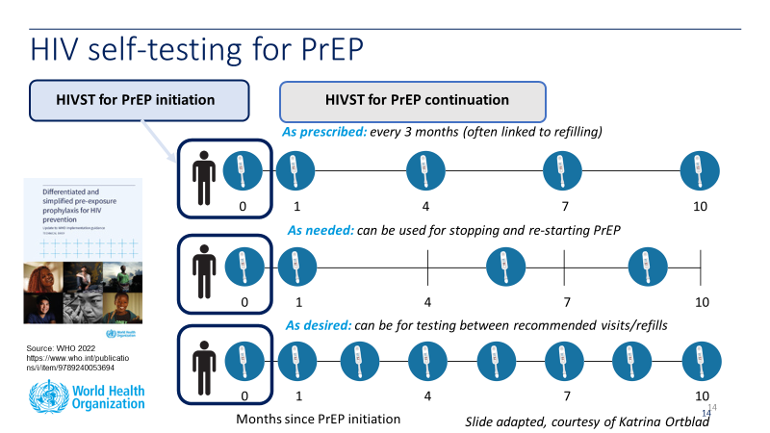
WHO new 2023 recommendations on HIV self-testing
New use Cases for HIVST
.
NEW: HIV self-testing may be used to deliver pre-exposure prophylaxis, including for initiation, re-initiation and continuation (conditional recommendation, low-certainty evidence)
NEW: HIV self-testing may be offered as an additional option for testing at facilities (conditional recommendation, low-certainty evidence).
NEW: Caregiver-assisted testing using HIVST: There is insufficient evidence to support caregiver-assisted testing using HIVST kits currently.
Therefore, prior to further implementation, challenges, concerns, and research gaps need to be addressed
WHO does urge already recommended approaches to reach children
EID
index/family testing
Indicator testing (eg testing in malnutrition clinics)
Screening tools to screen in for testing clinical settings

Slide 30
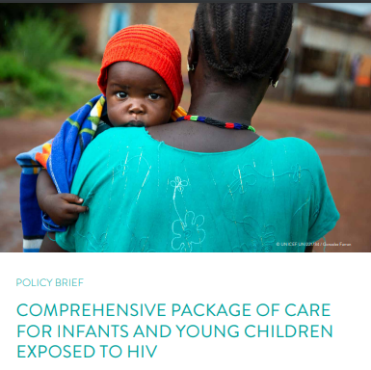
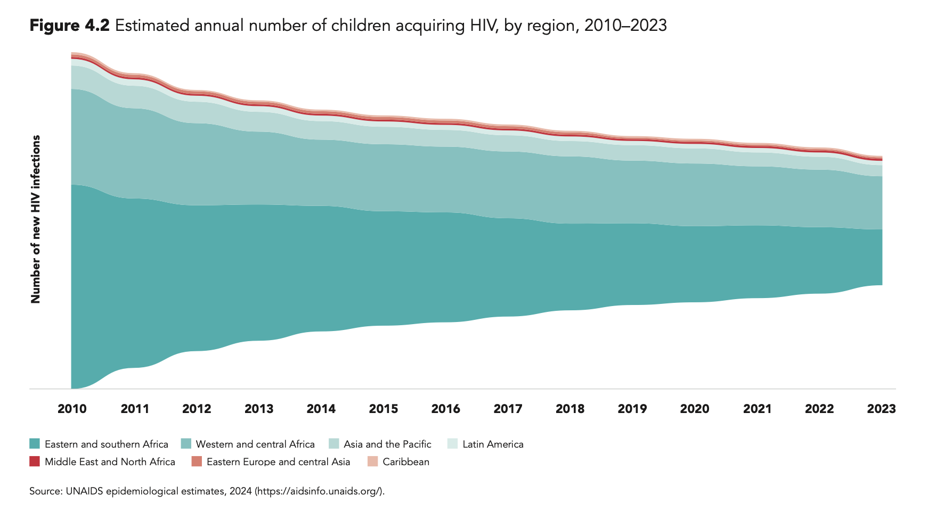
Early diagnosis of children
Where are we?
What are the latest recommendations?

Slide 31




Children are the ones left behind
Need to improve access to early diagnosis of children BUT:
Even if infants are tested within 2 months: results are not sent to parents
  Monitoring of the mother-child pair
62% of children living with HIV are between 5 and 14 years old
  Need to go beyond early diagnosis of children: CIDP (nutrition, vaccination, TB, etc.), intra-family screening
Notes:
In AOC, only 35% of children (<14 years old) know their status and only 35% of them are under treatment.
The % of children screened at 2 months decreases (red curve) in the AOC
The vast majority of mother-to-child transmission is due to the fact that mothers are not on ART (orange) or have stopped (light blue) their treatment during pregnancy or breastfeeding .

Slide 32

Early diagnosis algorithm for exposed infants : let's remember , it's a process!
Switch to a multi-test algorithm (HIV NAAT/NAT):
  Birth ( where this has a value-added )
  6 weeks
  9 months
  Every time infants exposed to HIV become ill
Ensure confirmation of positive results (second NAT test)
The diagnosis is only considered a “ final diagnosis” at the end of the transmission risk period.
https://www.who.int/publications/i/item/9789240031593​​
Notes:
Regarding early diagnosis of exposed infants. It is a process, several tests are required (NAT = nucleic acid amplification test) at different times between birth and the end of the period at risk of transmission (so 18 months or 3 months after the end of the breastfeeding): in particular 6 weeks and 9 months as well as whenever the child is sick.
It is absolutely necessary to confirm a result “ detected ” by a second test
The diag is only final at the end of the transmission risk period

Slide 33

2021 Recommendation : Early diagnosis of infants at the point of care (POC)
Decentralization of ART or strengthening of the link to care systems​​ remains of critical importance to ensure the impact on infants.
POC technologies must be considered and used as part of the algorithm's current diagnosis of infants at each time where a NAAT/NAT is necessary.
Access to quality diagnostic tests must be continually expanded to meet the needs in terms of screening and monitoring ( serology, molecular, CD4, etc.).
Resources​ human trained, proper maintenance, and insurance​ quality are of crucial importance.
POLICY ANALYSIS OF 31 COUNTRIES IN THE AFRO REGION (2022)
87.1% of programs national have reported adoption point-of -care infant diagnosis policy and receipt of approval regulatory national point-of -care infant diagnostic technologies , BUT the implementation implementation of the policy remains a challenge with low coverage ( up to 50%)
Notes:
POC and near POC are strongly recommended because they improve coverage . All the tests that I mentioned previously can be done using a POC
Of course you also need:
Decentralize the initiation of treatment or strengthen the link (and reduce the TAT for initiation of treatment)
Ensure that the tests are quality assured
To have trained HR, adequate maintenance and quality assurance activities
We note that despite the fact that 87% of countries report having adopted this recommendation, less than 50% of them have actually implemented it.
We have to do better than that

